Slide 1

Team technotuners
Aayush Malhotra
(E20CSE347)
Yogesh Harsana
(E20CSE349)
Manish Agarwal
(E20CSE357)
Yash Nigam
(E20CSE343)
Tanmay Goel
(E20CSE349)
Ananya Jain
(E20CSE359)

Slide 2
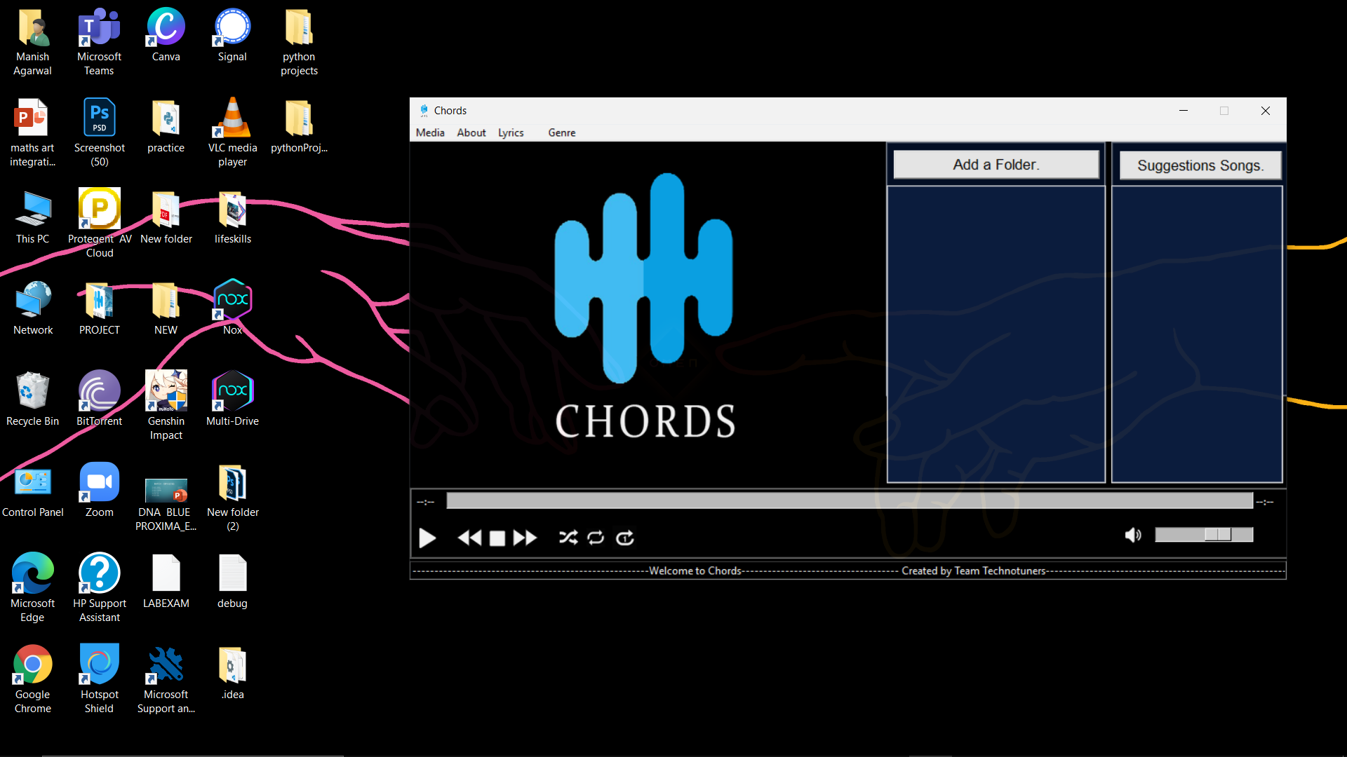

Slide 3
PROJECT DESCRIPTION
This is a music player application named as Chords. This have all the features required in a music player. This is an advanced music player made with python and Tkinter. The features included are -
1. Play/Pause
2. Next Track
3. Stop Music
4. Previous Track
5. Shuffle All

Slide 4
Other features included are –
6. Repeat All
7. Repeat One
8. Mute
9. Adjust Volume
10. Lyrics
11. User created playlists
13. Suggestions
14. Genre based songs

Slide 5
This advanced music player is a prototype of an online music player in the form of an offline music player where you can search the lyrics from the database and you can also play the song from the playlist on the basis of the genre.
For instance: you could play the song from the genre marked “country” which is itself a sub genre for the English music available in our music player.

Slide 6
For each and every genre we will have some suggested songs as well to keep your listening experience to the point and thoroughly enjoyable.
We have created a translucent, dark theme mode music player.
This music player also provides us For each and every genre we will have some suggested songs as well to keep your listening experience to the point and thoroughly enjoyable.
We have created a translucent, dark theme mode music player.
This music player also provides us with the status of the track being played at the moment.
THE MUSIC PLAYER WILL ALSO DISPLAY PROMPTS FOR THE DIFFERENT FEATURES IN USE IN OUR PROJECT.

Slide 7
solution
We plan to create a music player as our project that can be accessed Offline.
We will be using Pygame's mixer.music module for providing different functionality to our music player application that is usually related to the manipulation of the song tracks.
We are going to use the Tkinter library, which is a standard library for GUI creation. The Tkinter library is most popular and very easy to use and it comes with many widgets
By using the module mutagen, we will handle the metadata of the audio. It supports all types of audio files.

Slide 8
solution
This music player will also include downloaded files and will also contain the option to shuffle between different songs.
The project will also display the songs in queue in the current playlist.
There will also be an options menu that will display different settings such as audio, library, etc.
By using OS module, we will be fetching the playlist of songs from the specified directory and make it available to the music player application.

Slide 9
solution
We will also include songs from different languages and each language will consist of quite a few different sub – genres. These sub – genres (such as country, rock, pop, etc.)will include different songs within themselves and suggestions too.
We have used file handling and os module to search and access the lyrics for different songs which can be displayed simultaneously in a different window to increase your immersion in the music player.

Slide 10
Applications
We can use application as a offline mode .
We can get suggestion what to listen.
We can also search song lyrics easily from the software itself
We can play different playlist collection in the program as per the mood

Slide 11

INDIVIDUAL CONTRIBUTIONS
Aayush Malhotra- Songs database, creative manager, suggestions func, next-prev func
Ananya Jain- Logo design, progress bar, volume management func
Manish Agarwal- Assembling function, created entire interface, coordinator
Tanmay Goel- Lyrics func, lyrics database, debugger
Yash Nigam- Play-stop func, (random, repeat all, repeat one), project manager
Yogesh Harsana- Genre creator, researcher, testing, minor func

Slide 12
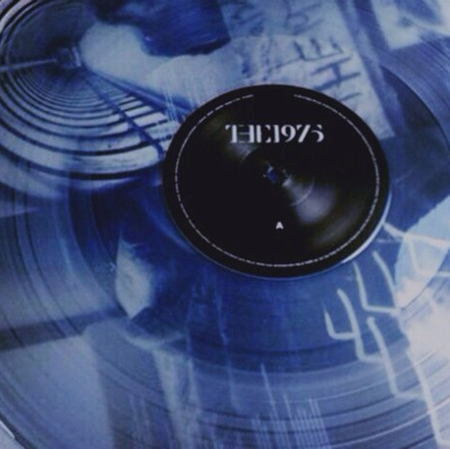
references
Github
Python Documentation
Youtube
Stack Overflow

Slide 13
Future Work
Work in the Api
Include The Visualizer(by using librosa ,mathplotlib,pygame)

Slide 14
Thank You!

